Slide 1

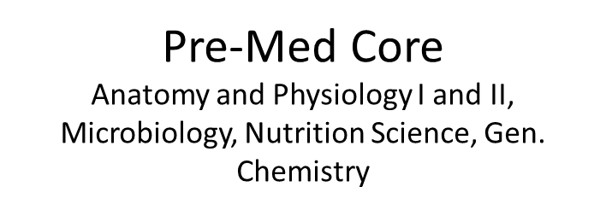


Nursing/ Pre-Medical/ Pre-Pharmacy/
Pre-Veterinarian Classes

